Slide 1
DeNovo: A Software-Driven Rethinking of the Memory Hierarchy
Sarita Adve, Vikram Adve,
Rob Bocchino, Nicholas Carter, Byn Choi, Ching-Tsun Chou,
Stephen Heumann, Nima Honarmand, Rakesh Komuravelli, Maria Kotsifakou,
Tatiana Schpeisman, Matthew Sinclair, Robert Smolinski,
Prakalp Srivastava, Hyojin Sung, Adam Welc
University of Illinois at Urbana-Champaign, Intel
denovo@cs.illinois.edu

Slide 2
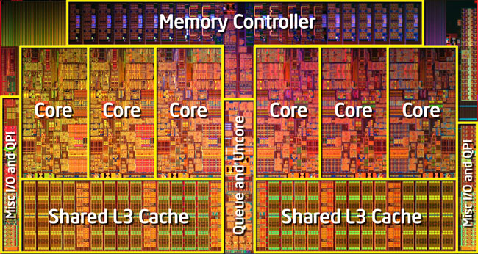
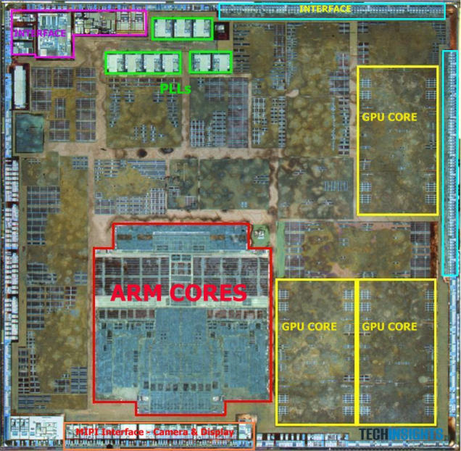
Silver Bullets for the Energy Crisis?
Parallelism
Specialization, heterogeneity, …
BUT large impact on
Software
Hardware
Hardware-Software Interface

Slide 3
Multicore Parallelism: Current Practice
Multicore parallelism today: shared-memory
Complex, power- and performance-inefficient hardware
Complex directory coherence, unnecessary traffic, ...
Difficult programming model
Data races, non-determinism, composability?, testing?
Mismatched interface between HW and SW, a.k.a memory model
Can’t specify “what value can read return”
Data races defy acceptable semantics
Fundamentally broken for hardware & software

Slide 4
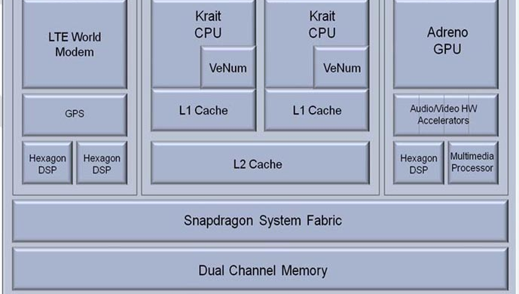
Specialization/Heterogeneity: Current Practice
A modern smartphone
CPU, GPU, DSP, Vector Units, Multimedia, Audio-Video accelerators
6 different ISAs
Even more broken
Incompatible
memory systems
7 different parallelism models

Slide 5
Energy Crisis Demands Rethinking HW, SW
How to (co-)design
Software?
Hardware?
HW / SW Interface?
Deterministic Parallel Java (DPJ)
DeNovo
Virtual Instruction Set Computing (VISC)
Today: Focus on homogeneous parallelism

Slide 6
Multicore Parallelism: Current Practice
Multicore parallelism today: shared-memory
Complex, power- and performance-inefficient hardware
Complex directory coherence, unnecessary traffic, ...
Difficult programming model
Data races, non-determinism, composability?, testing?
Mismatched interface between HW and SW, a.k.a memory model
Can’t specify “what value can read return”
Data races defy acceptable semantics
Fundamentally broken for hardware & software

Slide 7
Multicore Parallelism: Current Practice
Multicore parallelism today: shared-memory
Complex, power- and performance-inefficient hardware
Complex directory coherence, unnecessary traffic, ...
Difficult programming model
Data races, non-determinism, composability?, testing?
Mismatched interface between HW and SW, a.k.a memory model
Can’t specify “what value can read return”
Data races defy acceptable semantics
Banish shared memory?
Fundamentally broken for hardware & software

Slide 8
Multicore Parallelism: Current Practice
Multicore parallelism today: shared-memory
Complex, power- and performance-inefficient hardware
Complex directory coherence, unnecessary traffic, ...
Difficult programming model
Data races, non-determinism, composability?, testing?
Mismatched interface between HW and SW, a.k.a memory model
Can’t specify “what value can read return”
Data races defy acceptable semantics
Banish wild shared memory!
Need disciplined shared memory!
Fundamentally broken for hardware & software

Slide 9
What is Shared-Memory?
Shared-Memory =
Global address space
+
Implicit, anywhere communication, synchronization

Slide 10
What is Shared-Memory?
Shared-Memory =
Global address space
+
Implicit, anywhere communication, synchronization

Slide 11
What is Shared-Memory?
Wild Shared-Memory =
Global address space
+
Implicit, anywhere communication, synchronization

Slide 12
What is Shared-Memory?
Wild Shared-Memory =
Global address space
+
Implicit, anywhere communication, synchronization

Slide 13
What is Shared-Memory?
Disciplined Shared-Memory =
Global address space
+
Implicit, anywhere communication, synchronization
Explicit, structured side-effects
How to build disciplined shared-memory software?
If software is more disciplined, can hardware be more efficient?

Slide 14
Our Approach
Deterministic Parallel Java (DPJ): Strong safety properties
No data races, determinism-by-default, safe non-determinism
Simple semantics, safety, and composability
Simple programming model AND efficient hardware
explicit effects +
structured
parallel control
Disciplined Shared Memory
DeNovo: Complexity-, performance-, power-efficiency
Simplify coherence and consistency
Optimize communication and data storage

Slide 15
Key Milestones
Software
DPJ: Determinism
OOPSLA’09
Disciplined non-determinism
POPL’11
Unstructured synchronization
Legacy, OS
Hardware
DeNovo
Coherence, Consistency,
Communication
PACT’11 best paper
DeNovoND
ASPLOS’13 &
IEEE Micro top picks’14
DeNovoSynch (in review)
Ongoing
+ Storage
A language-oblivious virtual ISA

Slide 16
Current Hardware Limitations
Complexity
Subtle races and numerous transient states in the protocol
Hard to verify and extend for optimizations
Storage overhead
Directory overhead for sharer lists
Performance and power inefficiencies
Invalidation, ack messages
Indirection through directory
False sharing (cache-line based coherence)
Bandwidth waste (cache-line based communication)
Cache pollution (cache-line based allocation)

Slide 17
Results for Deterministic Codes
Complexity
No transient states
Simple to extend for optimizations
Storage overhead
Directory overhead for sharer lists
Performance and power inefficiencies
Invalidation, ack messages
Indirection through directory
False sharing (cache-line based coherence)
Bandwidth waste (cache-line based communication)
Cache pollution (cache-line based allocation)
Base DeNovo
20X faster to verify vs. MESI

Slide 18
Results for Deterministic Codes
Complexity
No transient states
Simple to extend for optimizations
Storage overhead
No storage overhead for directory information
Performance and power inefficiencies
Invalidation, ack messages
Indirection through directory
False sharing (cache-line based coherence)
Bandwidth waste (cache-line based communication)
Cache pollution (cache-line based allocation)
Base DeNovo
20X faster to verify vs. MESI

Slide 19
Results for Deterministic Codes
Complexity
No transient states
Simple to extend for optimizations
Storage overhead
No storage overhead for directory information
Performance and power inefficiencies
No invalidation, ack messages
No indirection through directory
No false sharing: region based coherence
Region, not cache-line, communication
Region, not cache-line, allocation (ongoing)
Base DeNovo
20X faster to verify vs. MESI
Up to 77% lower memory stall time
Up to 71% lower traffic

Slide 20
DPJ Overview
Structured parallel control
Fork-join parallelism
Region: name for set of memory locations
Assign region to each field, array cell
Effect: read or write on a region
Summarize effects of method bodies
Compiler: simple type check
Region types consistent
Effect summaries correct
Parallel tasks don’t interfere (race-free)
LD
ST
ST
ST
ST
heap
Type-checked programs guaranteed determinism (sequential semantics)

Slide 21
Memory Consistency Model
Guaranteed determinism ⇒ Read returns value of last write in sequential order
Same task in this parallel phase
Or before this parallel phase
Coherence
Mechanism
ST 0xa
ST 0xa
Parallel
Phase
LD 0xa

Slide 22
Cache Coherence
Coherence Enforcement
Invalidate stale copies in caches
Track one up-to-date copy
Explicit effects
Compiler knows all writeable regions in this parallel phase
Cache can self-invalidate before next parallel phase
Invalidates data in writeable regions not accessed by itself
Registration
Directory keeps track of one up-to-date copy
Writer updates before next parallel phase

Slide 23
Basic DeNovo Coherence [PACT’11]
Assume (for now): Private L1, shared L2; single word line
Data-race freedom at word granularity
No transient states
No invalidation traffic, no false sharing
No directory storage overhead
L2 data arrays double as directory
Keep valid data or registered core id
Touched bit: set if word read in the phase
Read
Invalid
Read
Valid
Write
Write
Registered
Read, Write
registry

Slide 24
Example Run
class S_type {
X in DeNovo-region ;
Y in DeNovo-region ;
}
S _type S[size];
...
Phase1 writes { // DeNovo effect
foreach i in 0, size {
S[i].X = …;
}
self_invalidate( );
}
L1 of Core 1
L1 of Core 2
R | X₀ | V | Y₀
R | X₁ | V | Y₁
R | X₂ | V | Y₂
V | X₃ | V | Y₃
V | X₄ | V | Y₄
V | X₅ | V | Y₅
R | X₀ | V | Y₀
R | X₁ | V | Y₁
R | X₂ | V | Y₂
I | X₃ | V | Y₃
I | X₄ | V | Y₄
I | X₅ | V | Y₅
V | X₀ | V | Y₀
V | X₁ | V | Y₁
V | X₂ | V | Y₂
V | X₃ | V | Y₃
V | X₄ | V | Y₄
V | X₅ | V | Y₅
I | X₀ | V | Y₀
I | X₁ | V | Y₁
I | X₂ | V | Y₂
R | X₃ | V | Y₃
R | X₄ | V | Y₄
R | X₅ | V | Y₅
V | X₀ | V | Y₀
V | X₁ | V | Y₁
V | X₂ | V | Y₂
V | X₃ | V | Y₃
V | X₄ | V | Y₄
V | X₅ | V | Y₅
V | X₀ | V | Y₀
V | X₁ | V | Y₁
V | X₂ | V | Y₂
R | X₃ | V | Y₃
R | X₄ | V | Y₄
R | X₅ | V | Y₅
Registration
Registration
Shared L2
R | C1 | V | Y₀
R | C1 | V | Y₁
R | C1 | V | Y₂
R | C2 | V | Y₃
R | C2 | V | Y₄
R | C2 | V | Y₅
Ack
V | X₀ | V | Y₀
V | X₁ | V | Y₁
V | X₂ | V | Y₂
V | X₃ | V | Y₃
V | X₄ | V | Y₄
V | X₅ | V | Y₅
Ack
R = Registered
V = Valid
I = Invalid

Slide 25
Decoupling Coherence and Tag Granularity
Basic protocol has tag per word
DeNovo Line-based protocol
Allocation/Transfer granularity > Coherence granularity
Allocate, transfer cache line at a time
Coherence granularity still at word
No word-level false-sharing
“Line Merging”
Cache
Tag
 |  | V |  |  | V | R
V | V |  |  |  |  |  | V

Slide 26
Current Hardware Limitations
Complexity
Subtle races and numerous transient sates in the protocol
Hard to extend for optimizations
Storage overhead
Directory overhead for sharer lists (makes up for new bits at ~20 cores)
Performance and power inefficiencies
Invalidation, ack messages
Indirection through directory
False sharing (cache-line based coherence)
Traffic (cache-line based communication)
Cache pollution (cache-line based allocation)
✔
✔
✔
✔

Slide 27
Flexible, Direct Communication
Insights
1. Traditional directory must be updated at every transfer
DeNovo can copy valid data around freely
2. Traditional systems send cache line at a time
DeNovo uses regions to transfer only relevant data
Effect of AoS-to-SoA transformation w/o programmer/compiler

Slide 28
Flexible, Direct Communication
L1 of Core 1
L1 of Core 2
…
…
R | X₀ | V | Y₀ | V | Z₀
R | X₁ | V | Y₁ | V | Z₁
R | X₂ | V | Y₂ | V | Z₂
I | X₃ | V | Y₃ | V | Z₃
I | X₄ | V | Y₄ | V | Z₄
I | X₅ | V | Y₅ | V | Z₅
I | X₀ | V | Y₀ | V | Z₀
I | X₁ | V | Y₁ | V | Z₁
I | X₂ | V | Y₂ | V | Z₂
R | X₃ | V | Y₃ | V | Z₃
R | X₄ | V | Y₄ | V | Z₄
R | X₅ | V | Y₅ | V | Z₅
X₃
Y₃
Z₃
…
LD X₃
Shared L2
…
…
R | C1 | V | Y₀ | V | Z₀
R | C1 | V | Y₁ | V | Z₁
R | C1 | V | Y₂ | V | Z₂
R | C2 | V | Y₃ | V | Z₃
R | C2 | V | Y₄ | V | Z₄
R | C2 | V | Y₅ | V | Z₅
Registered
Valid
Invalid
…

Slide 29
Flexible, Direct Communication
Flexible, Direct Communication
L1 of Core 1
L1 of Core 2
…
…
R | X₀ | V | Y₀ | V | Z₀
R | X₁ | V | Y₁ | V | Z₁
R | X₂ | V | Y₂ | V | Z₂
V | X₃ | V | Y₃ | V | Z₃
V | X₄ | V | Y₄ | V | Z₄
V | X₅ | V | Y₅ | V | Z₅
R | X₀ | V | Y₀ | V | Z₀
R | X₁ | V | Y₁ | V | Z₁
R | X₂ | V | Y₂ | V | Z₂
I | X₃ | V | Y₃ | V | Z₃
I | X₄ | V | Y₄ | V | Z₄
I | X₅ | V | Y₅ | V | Z₅
I | X₀ | V | Y₀ | V | Z₀
I | X₁ | V | Y₁ | V | Z₁
I | X₂ | V | Y₂ | V | Z₂
R | X₃ | V | Y₃ | V | Z₃
R | X₄ | V | Y₄ | V | Z₄
R | X₅ | V | Y₅ | V | Z₅
X₃
LD X₃
X₄
…
X₅
…
Shared L2
…
R | C1 | V | Y₀ | V | Z₀
R | C1 | V | Y₁ | V | Z₁
R | C1 | V | Y₂ | V | Z₂
R | C2 | V | Y₃ | V | Z₃
R | C2 | V | Y₄ | V | Z₄
R | C2 | V | Y₅ | V | Z₅
Registered
Valid
Invalid
…

Slide 30
Current Hardware Limitations
Complexity
Subtle races and numerous transient sates in the protocol
Hard to extend for optimizations
Storage overhead
Directory overhead for sharer lists (makes up for new bits at ~20 cores)
Performance and power inefficiencies
Invalidation, ack messages
Indirection through directory
False sharing (cache-line based coherence)
Traffic (cache-line based communication)
Cache pollution (cache-line based allocation)
✔
✔
✔
✔
✔
✔
✔
Stash=cache+scratchpad,
another talk

Slide 31
Evaluation
Verification: DeNovo vs. MESI word with Murphi model checker
Correctness
Six bugs in MESI protocol: Difficult to find and fix
Three bugs in DeNovo protocol: Simple to fix
Complexity
15x fewer reachable states for DeNovo
20x difference in the runtime
Performance: Simics + GEMS + Garnet
64 cores, simple in-order core model
Workloads
FFT, LU, Barnes-Hut, and radix from SPLASH-2
bodytrack and fluidanimate from PARSEC 2.1
kd-Tree (two versions) [HPG 09]

Slide 32
Memory Stall Time for MESI vs. DeNovo
M=MESI D=DeNovo Dopt=DeNovo+Opt
FFT
LU
Barnes-Hut
kd-false
kd-padded
bodytrack
fluidanimate
radix
DeNovo is comparable to or better than MESI
DeNovo + opts shows 32% lower memory stalls vs. MESI (max 77%)
Notes:
Execution time average is 17%, max is 60%

Slide 33
Network Traffic for MESI vs. DeNovo
M=MESI D=DeNovo Dopt=DeNovo+Opt
FFT
LU
Barnes-Hut
kd-false
kd-padded
bodytrack
fluidanimate
radix
DeNovo has 36% less traffic than MESI (max 71%)

Slide 34
Key Milestones
Software
DPJ: Determinism
OOPSLA’09
Disciplined non-determinism
POPL’11
Unstructured synchronization
Legacy, OS
Hardware
DeNovo
Coherence, Consistency,
Communication
PACT’11 best paper
DeNovoND
ASPLOS’13 &
IEEE Micro top picks’14
DeNovoSynch (in review)
Ongoing
+ Storage
A language-oblivious virtual ISA

Slide 35
DPJ Support for Disciplined Non-Determinism
Non-determinism comes from conflicting concurrent accesses
Isolate interfering accesses as atomic
Enclosed in atomic sections
Atomic regions and effects
Disciplined non-determinism
Race freedom, strong isolation
Determinism-by-default semantics
DeNovoND converts atomic statements into locks
.
.
.
LD
ST
.
.
.

Slide 36
Memory Consistency Model
Non-deterministic read returns value of last write from
Before this parallel phase
Or same task in this phase
Or in preceding critical section of same lock
self-invalidations as before
single core
.
.
.
ST 0xa
ST 0xa
Parallel
Phase
Critical
Section
LD 0xa
.
.

Slide 37
Coherence for Non-Deterministic Data
Coherence Enforcement
Invalidate stale copies in private cache
Track up-to-date copy
When to invalidate?
Between start of critical section and read
What to invalidate?
Entire cache? Regions with “atomic” effects?
Track atomic writes in a signature, transfer with lock
Registration
Writer updates before next critical section

Slide 38
Tracking Data Write Signatures
Small Bloom filter per core tracks writes signature
Only track atomic effects
Only 256 bits suffice
Operations on Bloom filter
On write: insert address
On read: query filter for address for self-invalidation

Slide 39
Distributed Queue-based Locks
Lock primitive that works on DeNovoND
No sharers-list, no write invalidation ⇒ No spinning for lock
Modeled after QOSB Lock [Goodman et al. ‘89]
Lock requests form a distributed queue
But much simpler
Details in ASPLOS’13

Slide 40
Example Run
X in DeNovo-region
Y in DeNovo-region
Z in atomic DeNovo-region
W in atomic DeNovo-region
L1 of Core 1
L1 of Core 2
lock transfer
Z W
lock transfer
Z W
R | X | V | Y
V | Z | V | W
R | X | V | Y
R | Z | V | W
R | X | V | Y
R | Z | I | W
R | X | V | Y
R | Z | V | W
R | X | V | Y
R | Z | I | W
V | X | R | Y
I | Z | V | W
V | X | R | Y
V | Z | V | W
V | X | R | Y
V | Z | R | W
V | X | R | Y
I | Z | R | W
V | X | R | Y
V | Z | V | W
ST
.
.
LD
ST
LD
Registration
Read miss
Read miss
Registration
Shared L2
R | C1 | R | C2
V | Z | V | W
Ack
R | C1 | R | C2
R | C1 | V | W
Ack
R | C1 | R | C2
R | C1 | R | C2
self-invalidate( )
self-invalidate( )
reset filter

Slide 41
Optimizations to Reduce Self-Invalidation
X in DeNovo-region
Y in DeNovo-region
Z in atomic DeNovo-region
W in atomic DeNovo-region
Loads in Registered state
Touched-atomic bit
Set on first atomic load
Subsequent loads don’t self-invalidate
ST
LD
.
.
LD
LD
self-invalidate( )

Slide 42
Overheads
Hardware Bloom filter
256 bits per core
Storage overhead
One additional state, but no storage overhead (2 bits)
Touched-atomic bit per word in L1
Communication overhead
Bloom filter piggybacked on lock transfer message
Writeback messages for locks
Lock writebacks carry more info

Slide 43
Evaluation of MESI vs. DeNovoND (16 cores)
DeNovoND execution time comparable or better than MESI
DeNovoND has 33% less traffic than MESI (67% max)
No invalidation traffic
Reduced load misses due to lack of false sharing

Slide 44
Key Milestones
Software
DPJ: Determinism
OOPSLA’09
Disciplined non-determinism
POPL’11
Unstructured synchronization
Legacy, OS
Hardware
DeNovo
Coherence, Consistency,
Communication
PACT’11 best paper
DeNovoND
ASPLOS’13 &
IEEE Micro top picks’14
DeNovoSynch (in review)
Ongoing
+ Storage
A language-oblivious virtual ISA

Slide 45
Unstructured Synchronization
Many programs (libraries) use unstructured synchronization
E.g., non-blocking, wait-free constructs
Arbitrary synchronization races
Several reads and writes
Data ordered by such synchronization may still be disciplined
Use static or signature driven self-invalidations
But what about synchronization accesses?

Slide 46
Unstructured Synchronization
Memory model: Sequential consistency
What to invalidate, when to invalidate?
Every read?
Every read to non-registered state
Register read (to enable future hits)
Concurrent readers?
Back off (delay) read registration

Slide 47
Unstructured Synch: Execution Time (64 cores)
DeNovoSync reduces execution time by 28% over MESI (max 49%)

Slide 48
Unstructured Synch: Network Traffic (64 cores)
DeNovo reduces traffic by 44% vs. MESI (max 61%) for 11 of 12 cases
Centralized barrier
Many concurrent readers hurt DeNovo (and MESI)
Should use tree barrier even with MESI

Slide 49
Key Milestones
Software
DPJ: Determinism
OOPSLA’09
Disciplined non-determinism
POPL’11
Unstructured synchronization
Legacy, OS
Hardware
DeNovo
Coherence, Consistency,
Communication
PACT’11 best paper
DeNovoND
ASPLOS’13 &
IEEE Micro top picks’14
DeNovoSynch (in review)
Ongoing
+ Storage
A language-oblivious virtual ISA

Slide 50
Conclusions and Future Work (1 of 3)
Deterministic Parallel Java (DPJ): Strong safety properties
No data races, determinism-by-default, safe non-determinism
Simple semantics, safety, and composability
Simple programming model AND efficient hardware
explicit effects +
structured
parallel control
Disciplined Shared Memory
DeNovo: Complexity-, performance-, power-efficiency
Simplify coherence and consistency
Optimize communication and storage

Slide 51
Conclusions and Future Work (2 of 2)
DeNovo rethinks hardware for disciplined models
For deterministic codes
Complexity
No transient states: 20X faster to verify than MESI
Extensible: optimizations without new states
Storage overhead
No directory overhead
Performance and power inefficiencies
No invalidations, acks, false sharing, indirection
Flexible, not cache-line, communication
Up to 77% lower memory stall time, up to 71% lower traffic
Added safe non-determinism and unstructured synchs

Slide 52
Conclusions and Future Work (3 of 3)
Broaden software supported
OS, legacy, …
Region-driven memory hierarchy
Also apply to heterogeneous memory
Global address space
Region-driven coherence, communication, layout
Stash = best of cache and scratchpad
Hardware/Software Interface
Language-neutral virtual ISA
Parallelism and specialization may solve energy crisis, but
Require rethinking software, hardware, interface

